Slide 1

Java Optmization
Dima Ionut Daniel

Slide 2
Contents
What is Java ?
History
Core
JVM
Operating System
Bibliography

Slide 3

What is Java?
Java is a programming language created by Sun Microsystems.
Java is used in a wide variety of computing platforms from embedded devices and mobile phones on the low end, to enterprise servers and supercomputers on the high end.
Java eliminates certain low-level constructs such as pointers and has a very simple memory model where every object is allocated on the heap and all variables of object types are references.
Memory management is handled through integrated automatic garbage collection performed by the JVM.
The heart of the Java platform is the concept of a "virtual machine" that executes Java bytecode programs. This bytecode is the same no matter what hardware or operating system the program is running under.

Slide 4
What is Java? (cont.)
There is a JIT(Just-In-Time) compiler within the Java Virtual Machine, or JVM. The JIT compiler translates the Java bytecode into native processor instructions at run-time and caches the native code in memory during execution. The use of a JIT compiler means that Java applications, after a short delay during loading and once they have "warmed up" by being all or mostly JIT-compiled, tend to run about as fast as native programs.
The Java programs are cross-platform or platform independent, but the code of the Java Virtual Machines (JVM) that execute these programs is not.

Slide 5
History
The initial Java release was named Oak, and the first stable version was JDK 1.0.2, called Java 1.
JDK 1.0 - 23 January 1996
JDK 1.1 – 19 February 1997
J2SE 1.2 – 8 December 1998 (codename Playground)
J2SE 1.3 – 8 May 2000 (codename Kestrel)
J2SE 1.4 – 6 February 2002 (codename Merlin)
J2SE 5.0 – 30 September 2004 (codename Tiger)
Java SE 6 – 11 December 2006 (codename Mustang)
Java SE 7 – 7 July 2011(codename Dolphin)
Java SE 8 is expected in summer 2013
The Java distribution comes in different flavors:
Java Card →run securely on smart cards and similar small-memory devices.
Java ME(Micro Edition) → Specifies several different sets of libraries (known as profiles) for devices with limited storage, display, and power capacities.
Java SE(Standard Edition) → for general-purpose use on desktop PCs, servers and similar devices.
Java EE(Enterprise Edition) → Java SE plus various APIs useful for multi-tier client–server enterprise applications.

Slide 6
Tools
On Unix-based systems, there are useful tools like vmstat, iostat,prstat, and so on.
On Windows, there are graphical resource monitors as well as command-line utilities like typeperf.
jcmd: Prints basic class, thread, and VM information for a Java process.
jconsole: Provides a graphical view of JVM activities, including thread usage, class usage, and GC activities.
jhat: Reads and helps analyze memory heap dumps. This is a post processing utility.
jmap: Provides heap dumps and other information about JVM memory usage.
jinfo: Provides visibility into the system properties of the JVM, and allows some system properties to be set dynamically.
jstack: Dumps the stacks of a Java process. Suitable for scripting.
jstat: provides information about GC and class-loading activities.
jvisualvm: A GUI tool to monitor a JVM, profile a running application, and analyze JVM heap dumps.

Slide 7
Core
The execution speed of Java code is highly dynamic and fundamentally depends on the underlying Java Virtual Machine (JVM).
The same piece of Java code may well execute faster on a more recent JVM, even without recompiling the Java source code.
Set of performance metrics:
Throughput
Latency
Capacity
Degradation
Utilization
Efficiency
Scalability

Slide 8
Core (cont.)
Throughput is a metric that represents the rate of work a system or subsystem can perform. This is expressed as number of units of work in some time period.
The capacity is the amount of work parallelism a system possesses.
The change in throughput as resources are added is one measure of the scalability of a system or application.
System scalability is dependent upon a number of factors, and is not normally a simple constant factor.

Slide 9
Core (cont.)
There is no doubt that Java is one of the largest technology platforms on the planet.
As a developer interested in performance, it's important to understand the basics of the JVM technology stack.
Understanding JVM technology enables developers to write better software.
The job of javac is to convert Java code into .class files that contain bytecode.
Very few optimizations are done during compilation by javac and the resulting bytecode is still quite readable and recognizable as Java code when viewed in a disassembly tool, such as the standard javap.

Slide 10
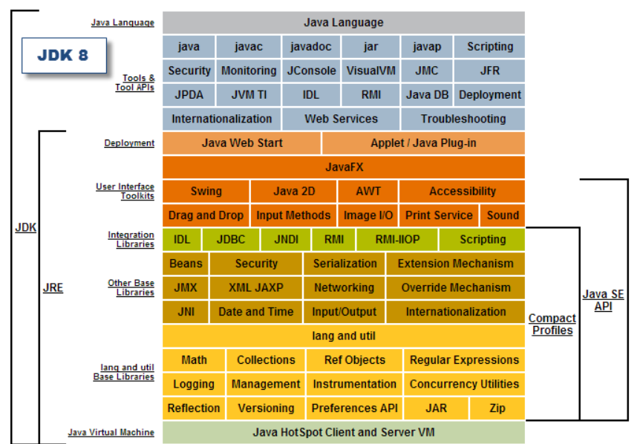
Core (cont.)

Slide 11
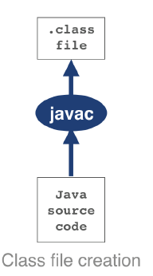
JVM
Bytecode is an intermediate representation that is not tied to a specific machine architecture.
Decoupling from the machine architecture provides portability, meaning developed software can run on any platform supported by the JVM and provides an abstraction from the Java language.

Slide 12
JVM (cont.)
Regardless of the source code compiler used, the resulting class file has a defined structure specified by the VM specification.
Any class that is loaded by the JVM will be verified to conform to the expected format before being allowed to run.

Slide 13
JVM (cont.)
Class anatomy:
Magic number: 0xCAFEBABE.
Class File Format Version: minor and major version of the class
Constant Pool: pool of constants for the class
Access Flags: indicators if the class is abstract, static, etc.
This Class: name of the current class
Super Class: name of the super class
Interfaces: any interfaces in the class
Fields: any fields in the class
Methods: any methods in the class
Attributes: any attributes of the class.

Slide 14
JVM (cont.)
Every class file starts with the magic number 0xCAFEBABE, the first 4 bytes in hexidecimal serving to denote the class file format.
The following 4 bytes represent the minor and major versions used to compile the class file.
The major minor version is checked by the classloader to ensure compatibility, if these aren't compatible an UnsupportedClassVersionError will be thrown at runtime.

Slide 15
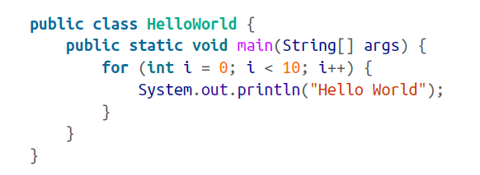
JVM (cont.)
We create a simple Java class that prints “Hello World”.

Slide 16
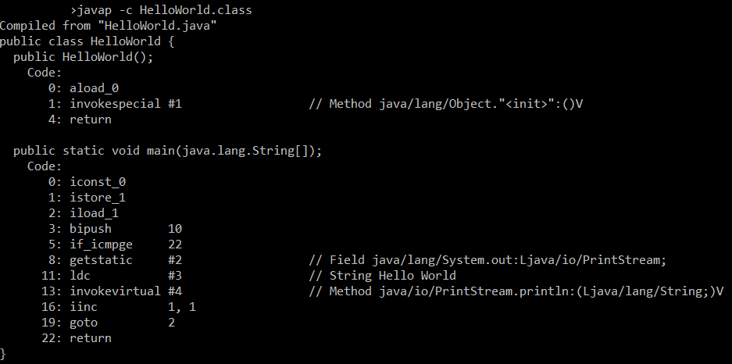
JVM (cont.)
Java ships with a class file disassembler called javap, allowing inspection of .class files.

Slide 17
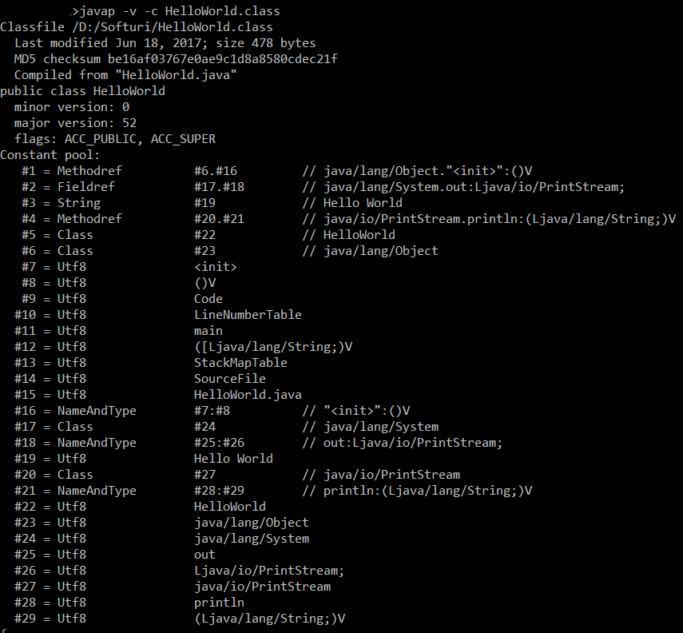
JVM (cont.)
javap also has a -v option that provides the full classfile header information and constant pool details.

Slide 18
JVM (cont.)
The first instruction executed in the constructor is aload_0, which places the this reference onto the first position in the stack.
The invokespecial command is then called, which invokes an instance method that has specific handling for calling super constructors and the creation of objects.
Opcodes in the JVM are concise and represent the type, the operation and the interaction between local variables, the constant pool and the stack.
iconst_0 pushes the int constant 0 onto the evaluation stack.
istore_1 stores this constant value into the local variable at offset 1.
The variable at offset 1 is then loaded back onto the stack and the constant 10 is pushed for comparison using if_icmpge (“if integer compare greater or equal”).

Slide 19
JVM (cont.)
The JVM is a stack based interpreted machine.
When our application is launched using the java HelloWorld command, the entry point into the application will be the main() method of HelloWorld.class.
The OS starts the virtual machine process and a chain of class loaders is initialized.

Slide 20
JVM (cont.)
This initial loader is known as the Bootstrap classloader, and contains classes in the core Java runtime.
In current versions these are loaded from rt.jar; this is changing in Java 9.
The Extension classloader is created next, it defines its parent to be the Bootstrap classloader, and will delegate to parent if needed.
Finally the Application classloader is created, which is responsible for loading in user classes from the defined classpath.

Slide 21
JVM (cont.)
Java loads in dependencies on new classes when they are first encountered during the execution of the program.
If a class loader fails to find a class it will try to delegate the lookup to the parent.
If the chain of lookups reaches the bootstrap class loader and isn’t found a ClassNotFoundException will be thrown.

Slide 22
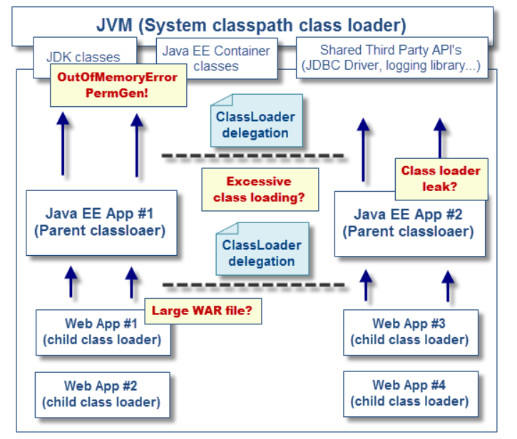
JVM (cont.)

Slide 23
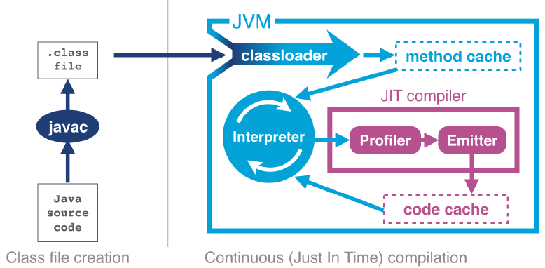
JVM (cont.)
HotSpot JVM

Slide 24
JVM (cont.)
In April 1999 Sun introduced one of the biggest changes to Java in terms of performance.
The HotSpot virtual machine is a key feature of Java that has evolved to enable performance that is comparative to languages such as C and C++.
HotSpot works by monitoring the application while it's running in interpreted mode and observing parts of code that are most frequently executed.
During this analysis process programmatic trace information is captured that allows for more sophisticated optimization.

Slide 25
JVM (cont.)
HotSpot Java Virtual Machine is composed of the following memory spaces:
Java Heap: Primary storage of the Java program class instances and arrays.
Permanent Generation(JDK 1.7 and older): primary storage for the Java class metadata.
Metaspace (JDK 1.8 and later): the PermGen space is replaced by the metaspace and using native memory.
Native Heap: native memory storage for the threads, stack, code cache including objects such as MMAP files and third party native libraries.

Slide 26
JVM (cont.)
The method of taking interpreted code and compiling once it passes a threshold is known as Just-In-Time(JIT) compilation.
One of the key benefits of JIT is having trace information that is collected during the interpreted phase, enabling HotSpot to make more optimizations.
HotSpot has improved with every new release.
HotSpot’s compilation subsystem is one of the two most important subsystems that the virtual machine provides. The other is automatic memory management.

Slide 27
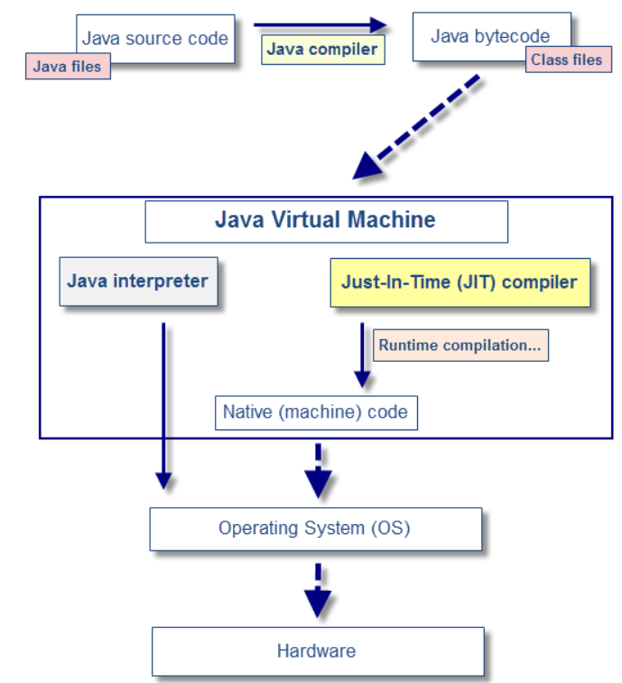
JVM (cont.)

Slide 28
JVM (cont.)
In languages such as C, C\++ and Objective-C the programmer is responsible for managing the allocation and releasing of memory.
The benefits of managing your own memory and lifetime of objects are more deterministic performance and the ability to tie resource lifetime to the creation and deletion of objects.
Java looked to help resolve the problem by introducing automatically managed heap memory using a process known as Garbage Collection (GC).
Garbage Collection is a non-deterministic process that triggers to recover and rescue no-longer needed memory when the JVM requires more memory for allocation.

Slide 29
JVM (cont.)
In order to provide efficient garbage collection, the Heap is essentially divided into sub areas.
Young Generation (nursery space)
Part of the heap reserved for allocation of new or short-lived objects.
Objects that have lived long enough in the young space are promoted to the old space.
Garbage is collected by a fast but stop-the-world YG collector.
Old Generation (tenured space)
Part of the heap reserved for long-lived objects.
Garbage is usually collected by a parallel or mostly concurrent collector.

Slide 30
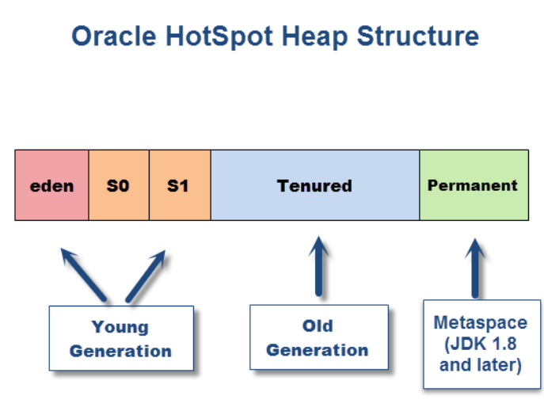
JVM (cont.)

Slide 31
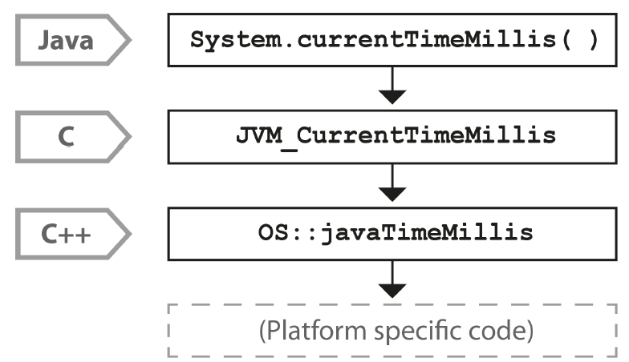
JVM (cont.)
Java and the JVM provide a portable execution environment that is independent of the OS.
Some fundamental services, such as thread scheduling the underlying operating system must be accessed.
This capability is provided by native methods, which are denoted by the keyword native.
They are written in C, but are accessible as ordinary Java methods using JNI(Java Native Interface).

Slide 32
JVM (cont.)
The native System.currentTimeMillis() method is mapped to the JVM entry point method JVM_CurrentTimeMillis.
The mapping is done via the JNI Java_java_lang_System_registerNatives mechanism contained in java/lang/System.c.
This method is defined in the os namespace, and is unsurprisingly operating system-dependent.

Slide 33
JVM (cont.)
JDK 1.8 Metaspace
By default, the Metaspace memory space is unbounded and will use the available process and/or OS native memory available for dynamic expansions.
The memory space is divided into chunks and allocated by the JVM via mmap.
The JVM option -XX:MaxMetaspaceSize=<NNN> allows to limit the amount of native memory committed for class metadata.
It is recommended to use it as a safeguard mechanism when facing physical resources (RAM) constraints and other scenarios such as the presence of memory leaks.

Slide 34
Operating System
The software platforms that run on that hardware has also increased in complexity to exploit the new capabilities.
The point of an operating system is to control access to resources that must be shared between multiple executing processes.
All resources are finite, and all processes are greedy, so the need for a central system to arbitrate and meter access is essential.
The two most important resources are memory and CPU time.
The use of the buffers improves performance for software’s access time to memory.

Slide 35
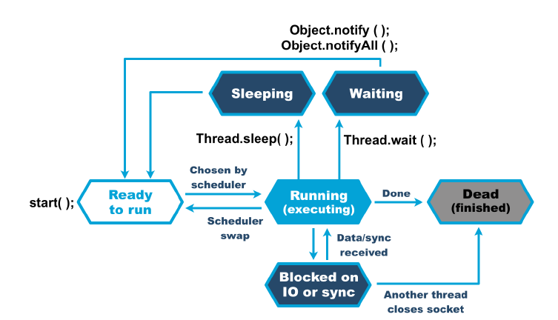
Operating System (cont.)
Access to the CPU is controlled by the process scheduler.
It uses a queue named “run queue” as a waiting area for threads or processes that are eligible to run but which must wait their turn for the CPU.
On a modern system there are effectively always more threads / processes that want to run than can, and so this CPU contention requires a mechanism to resolve it.
The job of the scheduler is to respond to interrupts, and to manage access to the CPU cores.

Slide 36
Operating System (cont.)
The OS scheduler moves threads on and off the single core in the system.
At the end of the time quantum, the scheduler moves the thread to the back of the run queue to wait until it reaches the front of the queue and is eligible to run again.
If a thread wants to voluntarily give up its time quantum it can do so either for a fixed amount of time (via sleep()), or until a condition is met (using wait()). Finally, a thread can also block on I/O or a software lock.

Slide 37
Operating System (cont.)
Context switches can be a very costly operation, whether between user threads or from user mode into kernel mode.
A context switch into kernel mode will invalidate the TLBs and potentially other caches.
When the call returns, these cashes will have to be refilled and so the effect of a kernel mode switch persists even after control has returned to user space.

Slide 38
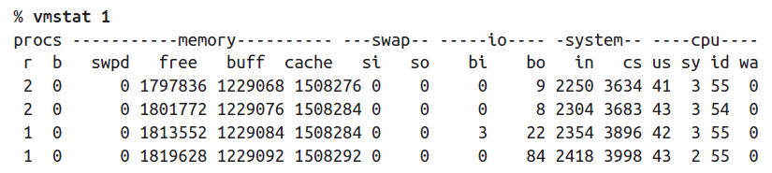
Operating System (cont.)
CPU usage is divided in 2 categories: user time and system time.
User time is the percentage of time the CPU is executing application code.
System time is the percentage of time the CPU is executing kernel code.
The goal in performance is to drive CPU usage as high as possible for a short time as possible.
vmstat is a good Linux utility.

Slide 39
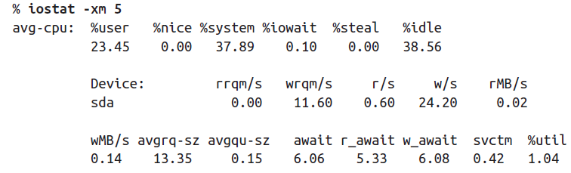
Operating System (cont.)
Monitoring disk usage can indicate if the application is doing lot of disk I/O.
Knowing when disk I/O is a bottleneck is tricky because it depends on the behavior of the application.
If the application is performing more I/O than the disk can handle the disk I/O statistics will be high.
The iostat utility on Linux can be used.

Slide 40

Operating System (cont.)
Network usage is similar to disk traffic.
The application can be inefficient using network if the bandwidth is to low.
On Unix system the basic network tool is netstat.
There are many open source and commercial tools that monitor network bandwidth.

Slide 41

Bibliography
https://dzone.com/refcardz/java-performance-optimization
OReilly Optimizing Java
Oreilly Java Performance The Definitive Guide
Java Performance Companion

